Slide 1

AX App Proposal
Specialist: Michelle Legasto, PT
Programmers: Felipe Clark, Ritam Haldar

Slide 2

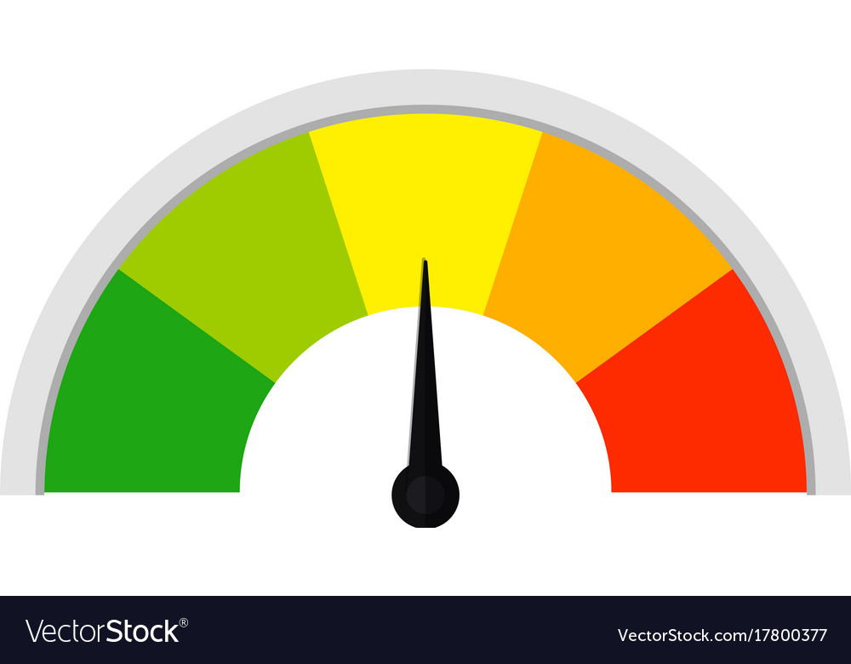


Background
60K Canadians/year
70% poor cardiovascular fitness
Aerobic Exercise

Slide 3

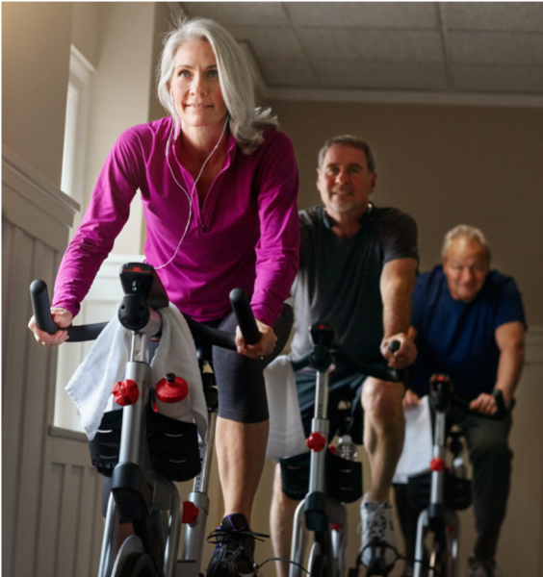


App Goal
Help stroke survivors engage in regular and effective aerobic exercise to improve their cardiovascular fitness
Many stroke survivors have difficulty engaging in and sustaining aerobic exercise ​
Use information from heart rate tracker to provide feedback to users regarding how well they are meeting the aerobic exercise recommendations.​

Slide 4
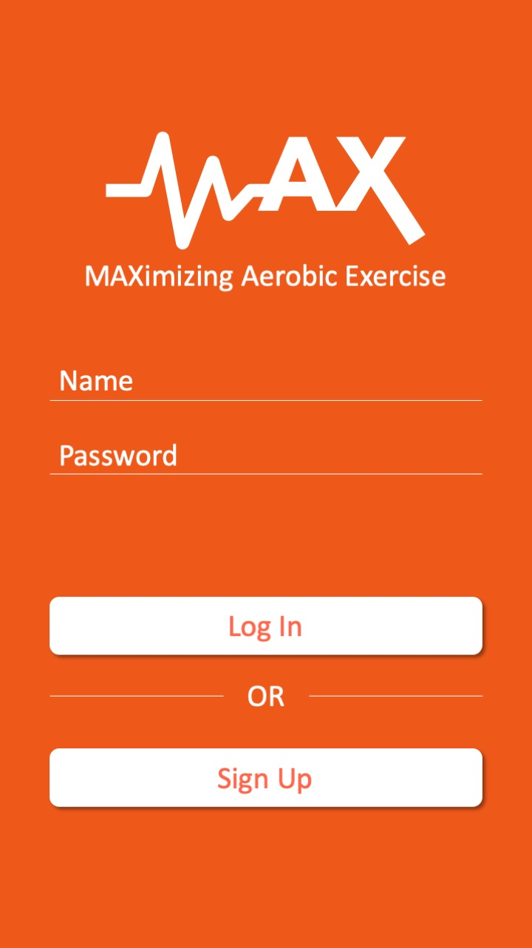
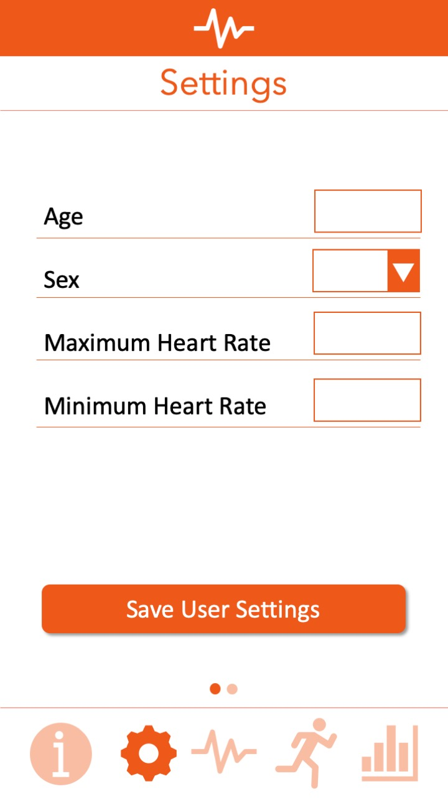
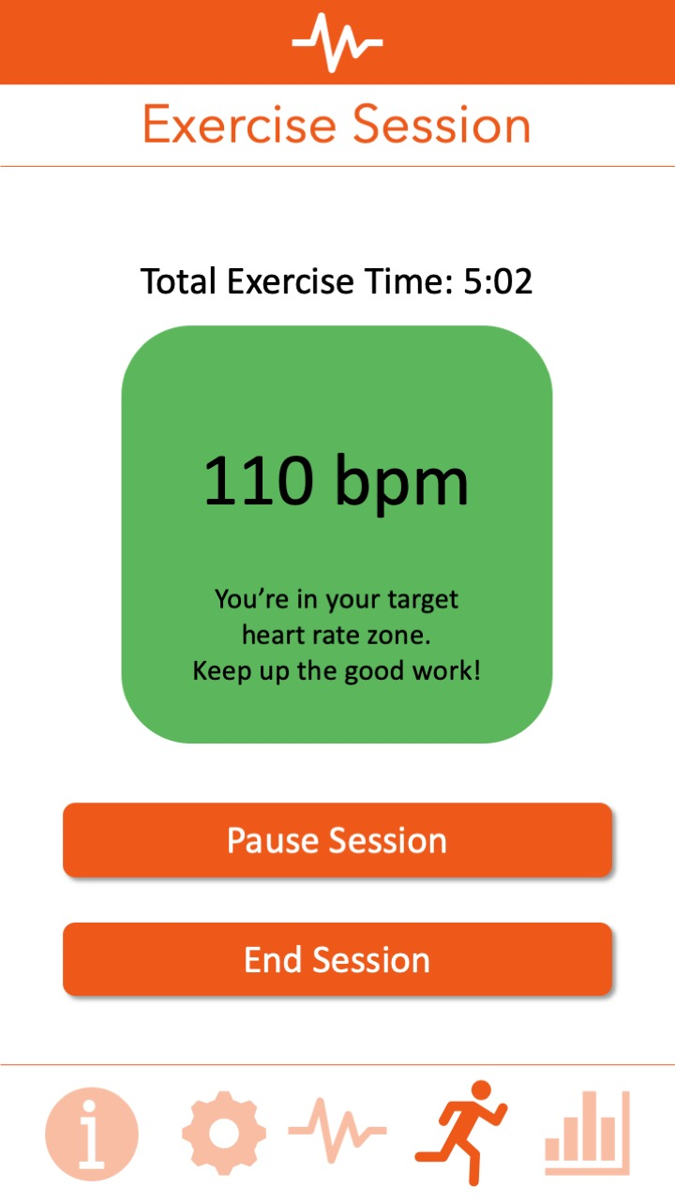
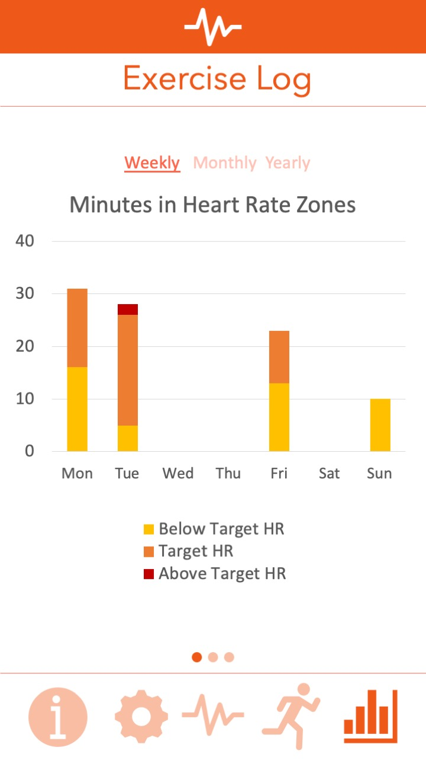
App Design

Slide 5
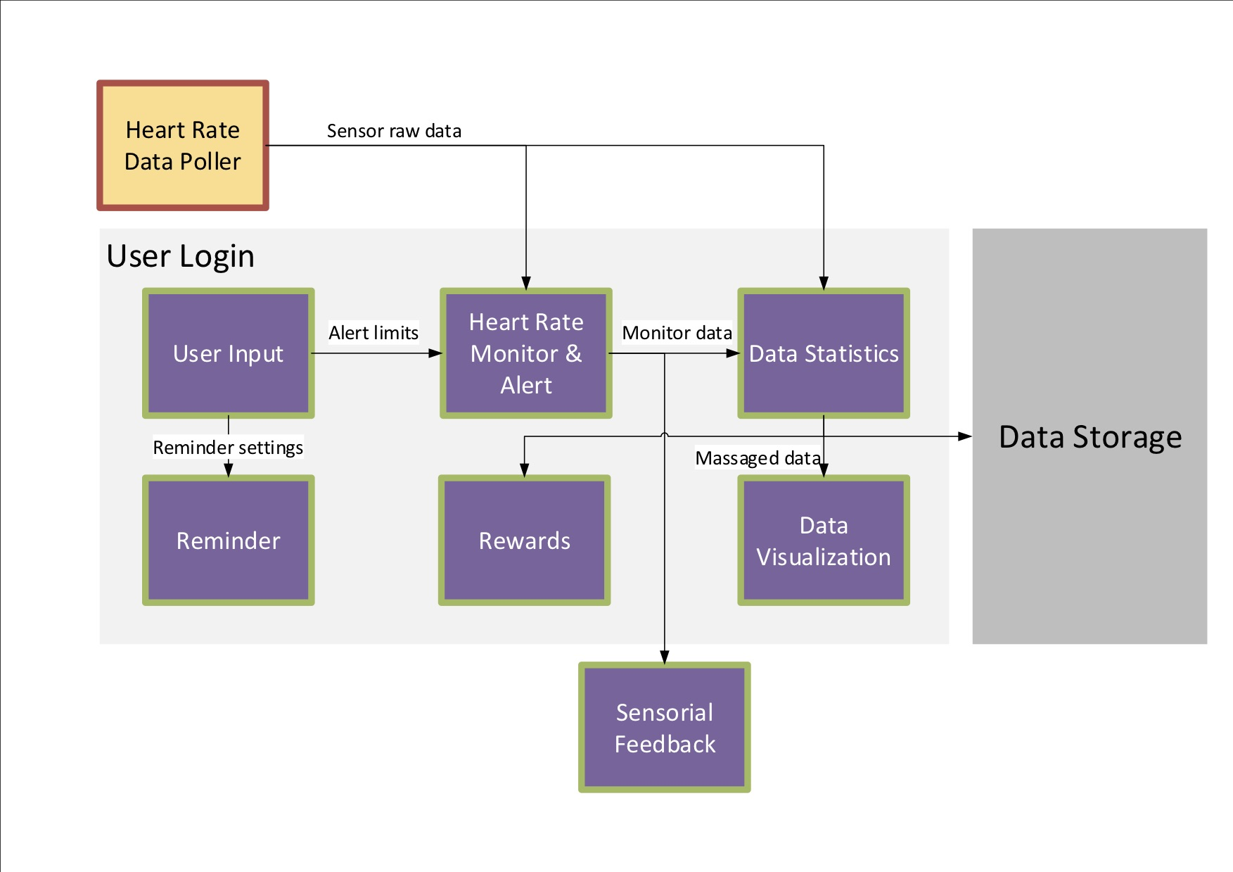
Block Diagram

Slide 6



Risk and Issues
Heart Rate Data Poller
Graphic API usage
Advanced UI Features

Slide 7

Spiral 1 Targets
Primary:
User login
Heart rate tracking and alert
Item Dashboard
Item User input (min/ max heart rate)

Slide 8
Spiral 2 Targets
Secondary:
Exercise characteristics tracker
Exercise log
Exercise progression
Goal entry (exercise length)

Slide 9
Specialist Statement
Provide key information from my area of expertise to maximize value of the MAX app
Test the various iterations of the MAX app
Track and address issues on GitHub
Assist with designing User Interface

Slide 10


